Slide 1


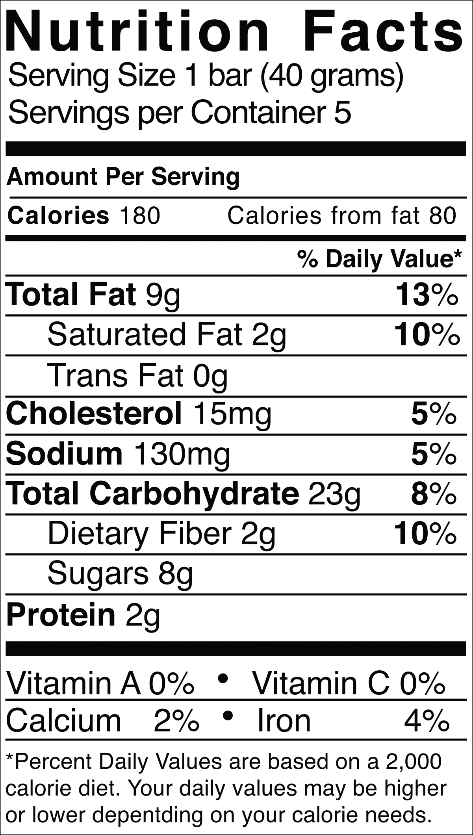
What makes it the best
A Capstone Presentation by Tejas Sridhar, MSBA
Streamlined Commodities Pricing
With added emphasis on customer analysis
v
Agenda
Introduction to the proposed project
Exploratory Data Analysis and Assumptions
The ML Pipeline
Model Selection
Result and Accuracy
Customer Analysis
v
Proposed Methodology
Conclusion
Recommendations
Questions
*The recommendations are subject to base assumptions and may be higher or lower depending on working capital.

Slide 2
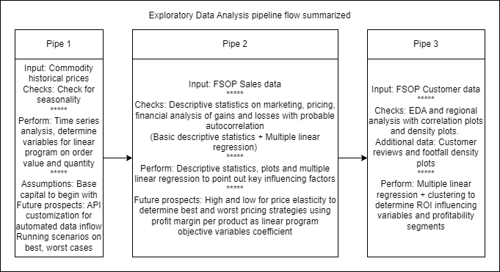
Introduction to the proposed project

Slide 3
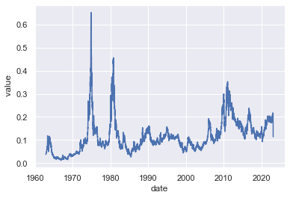
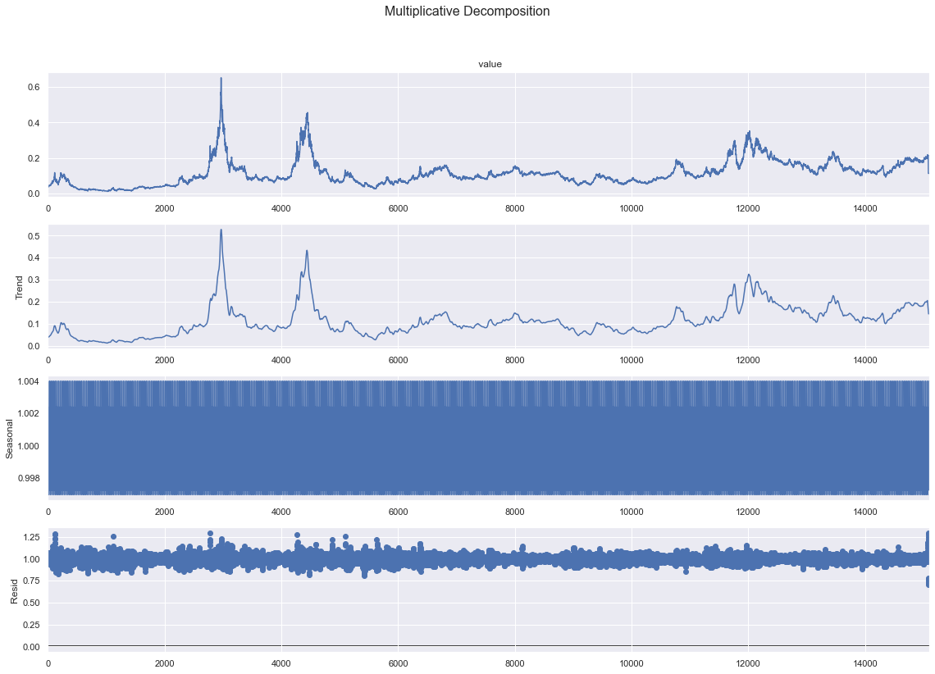
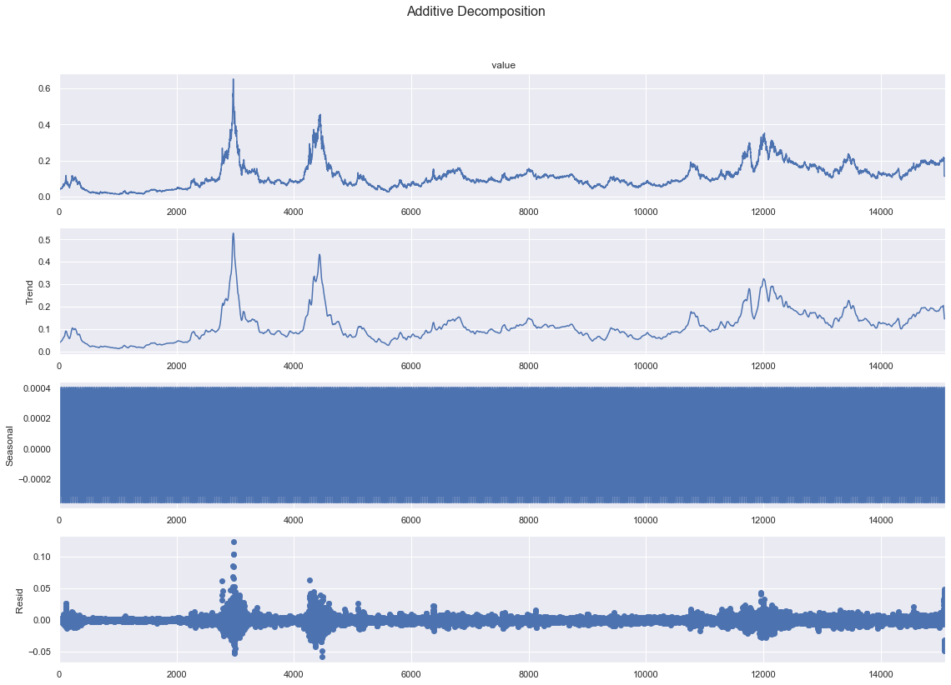
Exploratory Data Analysis and Assumptions - Sugar

Slide 4
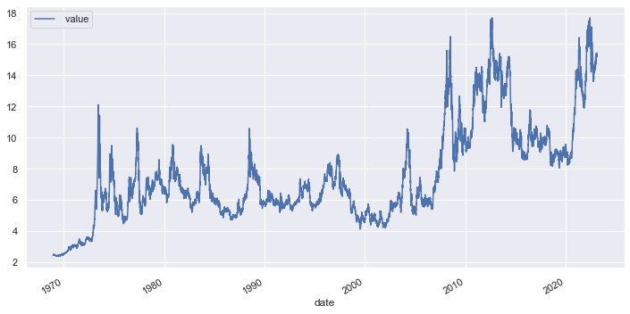
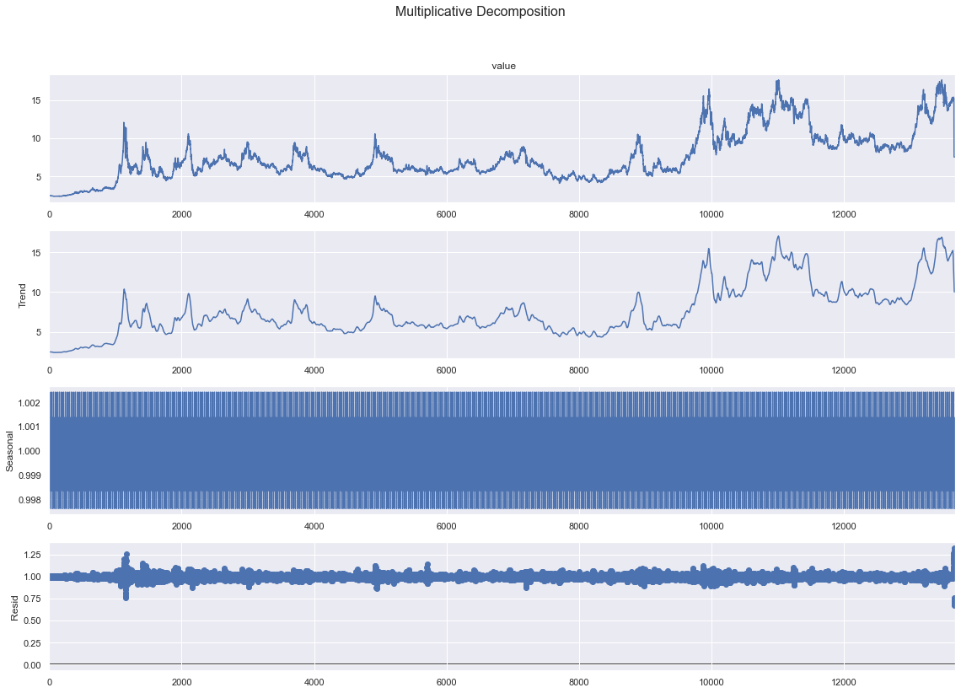
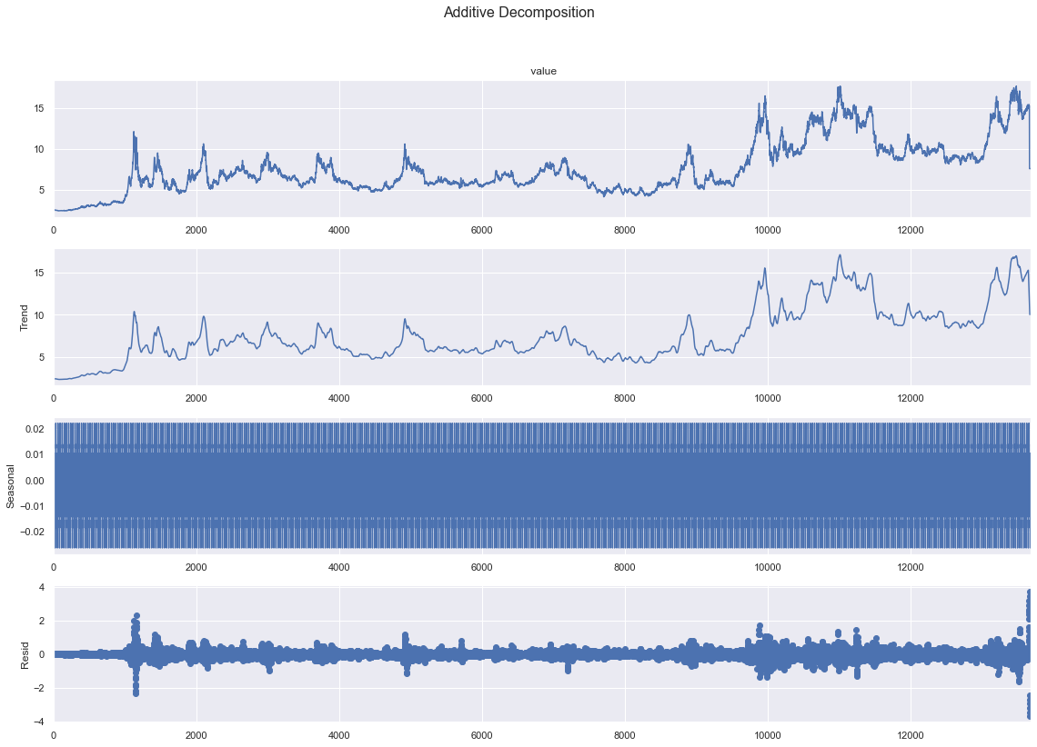
Exploratory Data Analysis and Assumptions - Soyabean

Slide 5
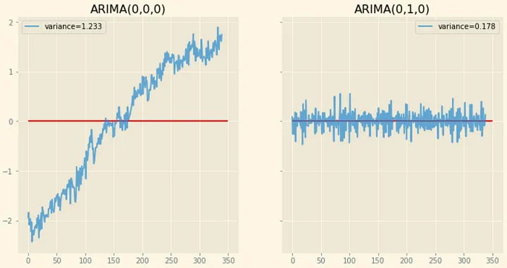
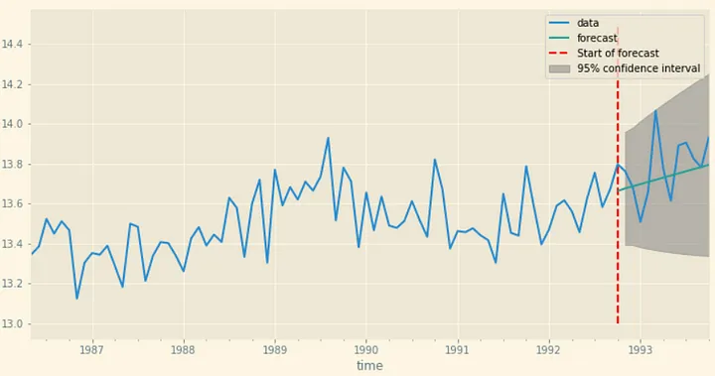
The ML Pipeline – Model Selection
Stationary Vs Trended data

Slide 6
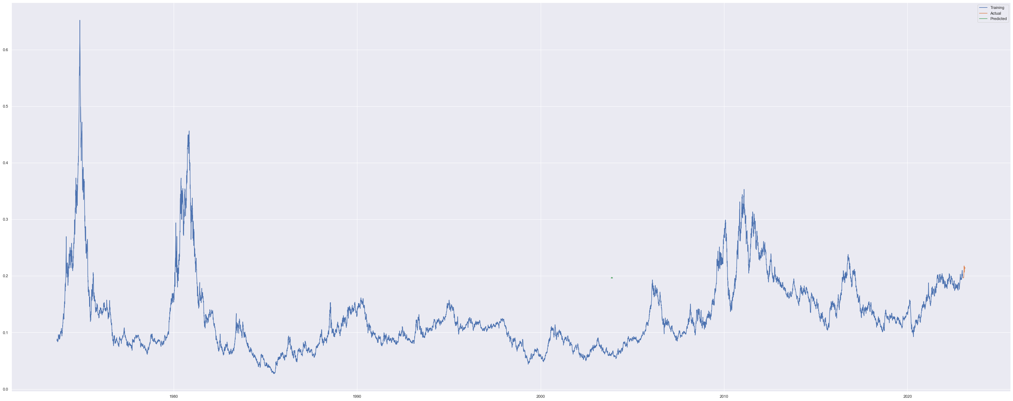
The ML Pipeline – Result and Accuracy
Take Sugar, for example

Slide 7
The ML Pipeline – Result and Accuracy
Commodity | RMSE
Sugar | 0.0128
Soyabean | 0.2464
Cotton | 14.37
Corn | 0.2438
Coffee | 0.1625
Scenarios Analysis with linear programming

Slide 8
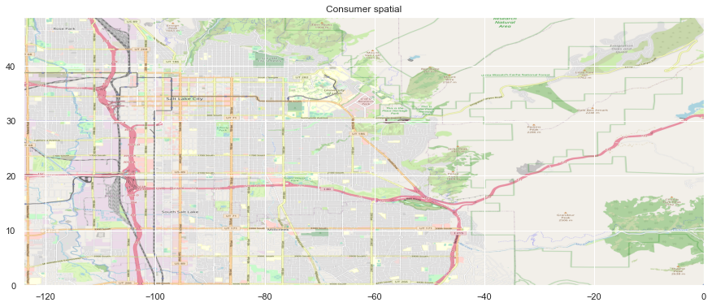
Customer Analysis
Why Clustering fails in spatial data?

Slide 9
Customer Analysis – Proposed methodology
Why Clustering fails in spatial data?
Insights from being undercover

Slide 10
Conclusion

Slide 11
Recommendations
The causality
The optimized supply chain
The profitability trap

Slide 12
Questions?

